Slide 1

RETAINING THE ROCKS
What makes White Rock’s Customers stay and/or go?
BC2406 Seminar Group 3 Team 7
Bairi Sahitya, Cai Xinrui, Ernest Ang Cheng Han, Malcolm Tan Yen Da

Slide 2
THE BUSINESS PROBLEM

Slide 3

CUSTOMER RETENTION
One of the key success metrics of any organisation
Traditional Collection Method: Customer Satisfaction Survey
Time Lag
No objective way of verifying data
Frequent surveys lead to customer burnout
Malcolm

Slide 4


THE BENEFITS OF RETENTION
High customer retention brings about GREATER profits through:
Higher Revenue: A retained customer is 60-70% more likely to purchase
Lower Cost: FREE marketing through the word-of-mouth
Malcolm

Slide 5
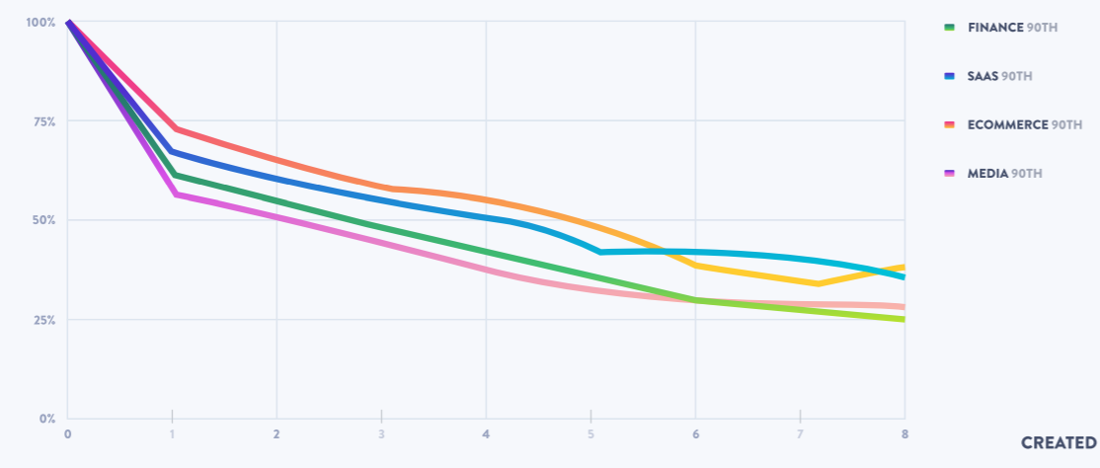
WHY IS THIS RELEVANT?
Retention is particularly poor in the Finance (Asset Management) Industry; likely caused by huge supply of investment firms.
Malcolm

Slide 6


WHAT AFFECTS IT
INTERNAL VARIABLES
Have control over
Eg: NumberOfComplaints
EXTERNAL VARIABLES
No control over
Eg: Gender
Malcolm

Slide 7

THE BUSINESS PROBLEM
The focus of our analysis and proposed solution will be on...
CUSTOMER RETENTION
IMPORTANT FACTORS WHITE ROCK
and their
for
Malcolm

Slide 8
THE ANALYTICS SOLUTION

Slide 9

AUTOMATED ANALYTICS PROCESS
Increasing trend of companies utilizing data-driven processes to draw meaningful insights
Opportunity: To provide faster and more accurate retention predictions
Malcolm

Slide 10



RETENTION ANALYSIS MODEL
Identifies customers of White Rock who are at high risk of leaving
Identify factors that have the greatest impact on customer retention
Malcolm

Slide 11
PROJECT FEASIBILITY
Imperfect Knowledge: Lack of full awareness of customer’s intentions
Predictive Need: Retention and factors for timely intervention
Available Training Data: Credible and Relevant
Malcolm

Slide 12



DESIRED BUSINESS OUTCOMES
Identifying Customers for Targeted Retention Efforts
Improving Resource Allocation and Reducing Cost
Malcolm

Slide 13
DATA
EXPLORATION INSIGHTS

Slide 14


Data Preparation
Original Dataset
10000 rows and 14 columns
Primary key attribute = CustomerID
Created Variables
8 variables
7 internal + 1 external
Xin Rui

Slide 15
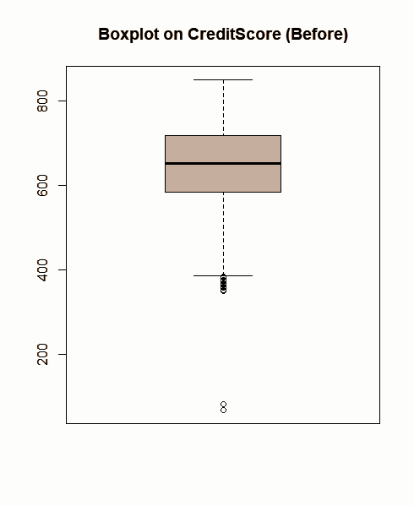
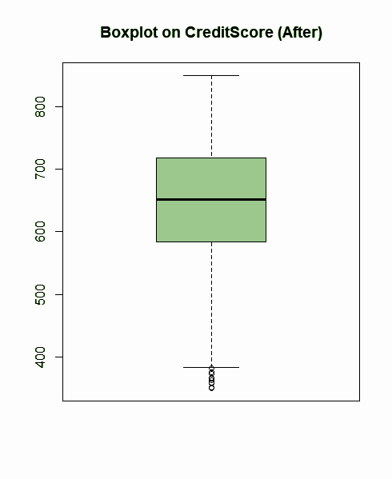


Data Cleaning
Outliers in Credit Score
Resolved by correcting the values.
Xin Rui

Slide 16

Data Cleaning
2.Redundant Data (HasCreditCr)
Resolved by removing the column
Xin Rui

Slide 17

Data Cleaning
3. NAs in variable Financial Literacy and Last Contact by a Banker
Resolved by removing the 3 rows
Xin Rui

Slide 18
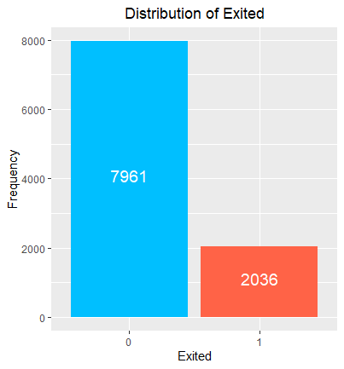
Distribution of Exited
Binary output variable
20.4% versus 79.6%
Stratified during train-test split in Logistic Regression model
Xin Rui

Slide 19
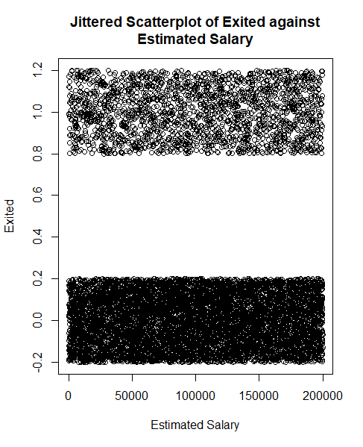
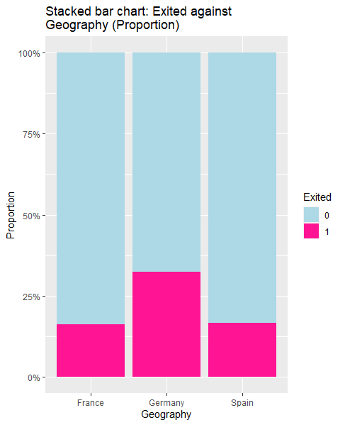
Findings in the original dataset
German branch has more customers leaving
Estimated Salary is uniformly distributed so it should not be an influential factor
Xin Rui

Slide 20
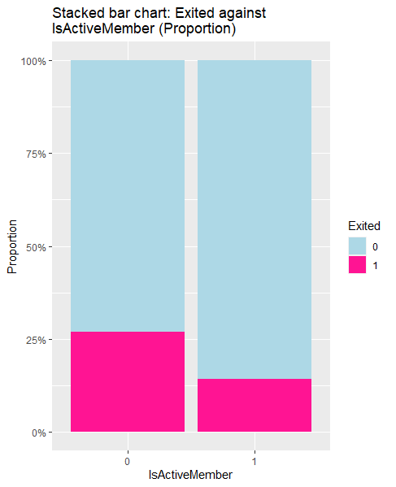
Findings in the original dataset
The only internal variable “IsActiveMember” showed that Active members have a lower chance of leaving, half of that as compared to inactive members.
26.9% versus 14.3%
Xin Rui

Slide 21
THE MODEL: LOGISTIC REGRESSION

Slide 22
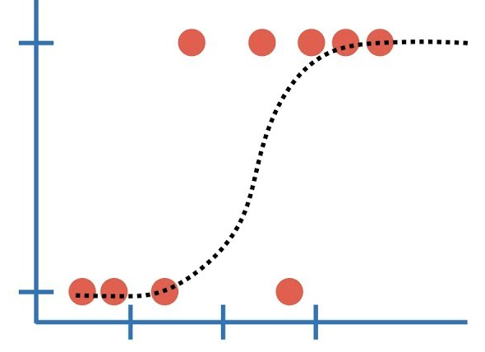
Logistic Regression Overview
Backward Elimination was run on all the variables
Final model consisted of only input variables, are statistically significant at 5% 𝛂
Clustering was performed but no clear cluster was formed
Xin Rui

Slide 23
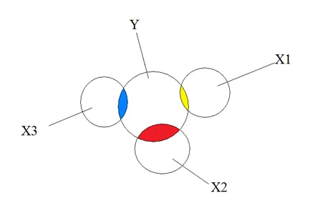
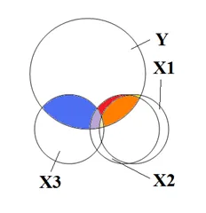
Multicollinearity Issues
The Adjusted GVIF values of the final model are all below 2, suggesting that there are no multicollinearity issues between the explanatory variables.
Xin Rui

Slide 24
Results
Predicted Values
 | Retained (Negative) | Exit (Positive)
Retained (Negative) | 2339 (78%) | 49 (1.6%)
Exit (Positive) | 84 (2.8%) | 527 (17.6%)
Actual
Values
Accuracy: 95.6% Type I Error: 2.05% Type II Error: 13.8%
Xin Rui

Slide 25










Insights (Top 5 significant factors)
Xin Rui

Slide 26
THE MODEL: CLASSIFICATION &
REGRESSION TREE (CART)

Slide 27

CART Overview
Utilizes classification & regression to make predictions
Trains & tests data set via 10 fold cross validation algorithm
Generating model:
Phase 1: Growing to maximum
Phase 2: Pruning to minimum
Ernest

Slide 28
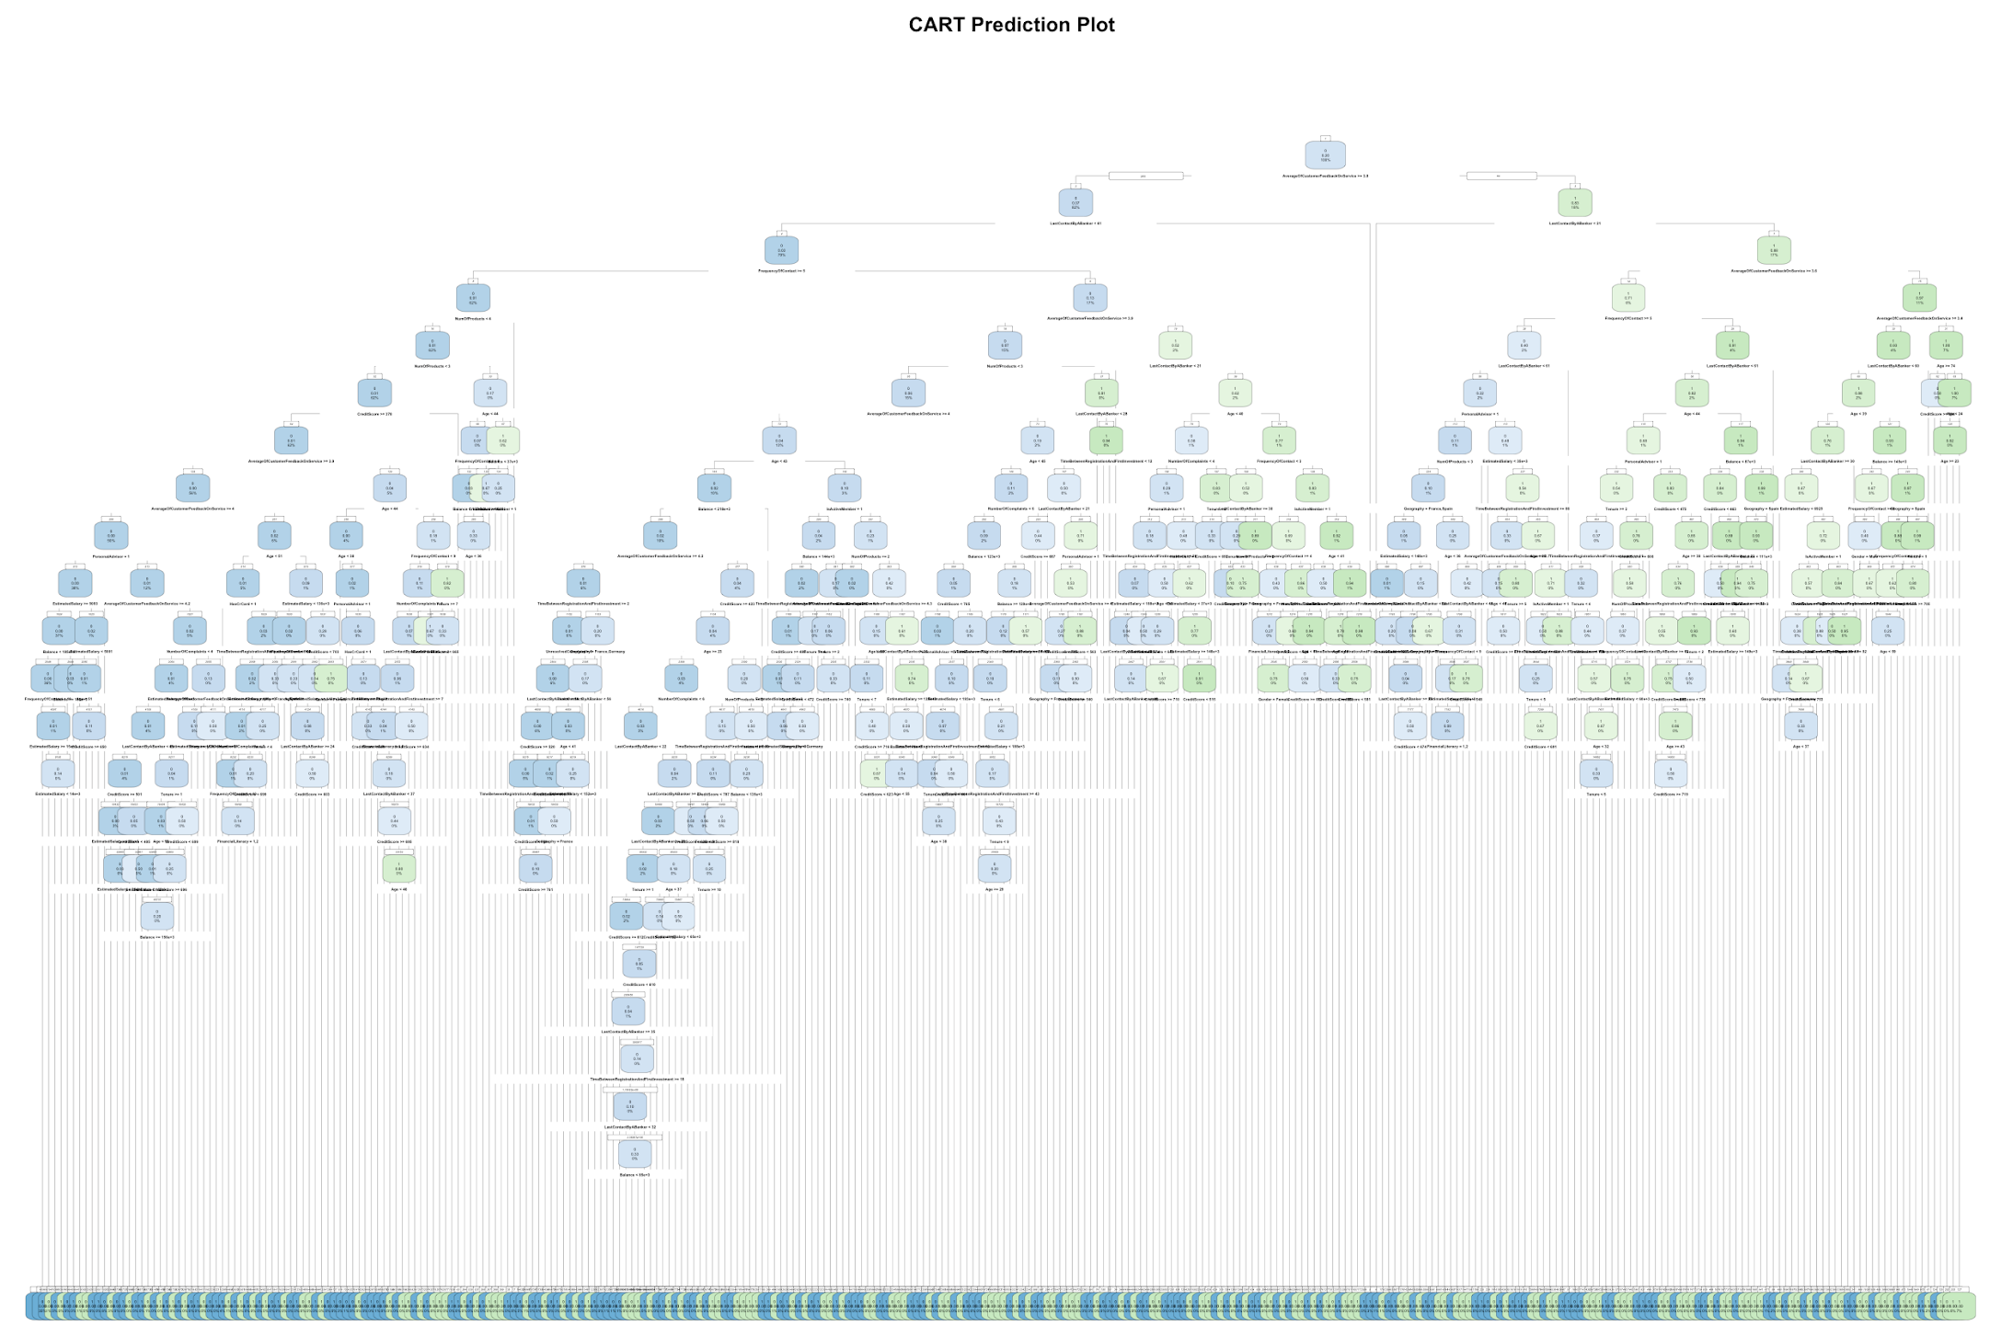
CART Phase 1: Growing
Selecting best split point at each node of CART model
Each node produces 2 child nodes of the highest possible purity
Process continues till a lenient stopping condition is met
Problem: Overfitting!
Ernest

Slide 29

CART Phase 1: Growing
Due to the many variables used, problem of overfitting is observed
CART was grown to its maximum by setting the complexity penalty to 0 units per terminal node
Hence, CART needs to be pruned to its minimum size
Problem: Where?
Ernest
Notes:
Many variables = high complexity

Slide 30

CART Phase 2: Pruning
Answer: Weakest Link
Prune the tree at its weakest link to obtain the most optimal tree
Weakest Link definition: minimum value of complexity penalty that would trigger pruning
Problem: How?
Ernest
Notes:
Many variables = high complexity

Slide 31
CART Phase 2: Pruning
Step 4:
Minimum complexity penalty derivation: geometric complexity penalty mean of simplest tree
Step 1:
Identify tree with lowest cross validation error
Step 3:
Identify simplest tree (nearest node) whose cross validation error is below the error cap
4
Step 2:
Calculate the cross validation error cap
Ernest
Notes:
Many variables = high complexity

Slide 32
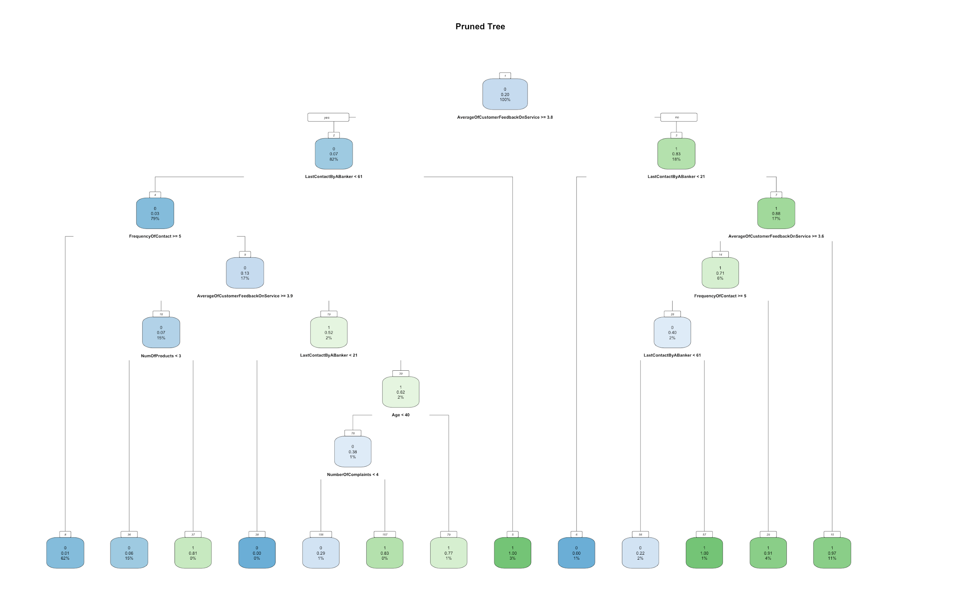
CART Phase 2: Pruning
Before:
After:
Ernest
Notes:
Many variables = high complexity

Slide 33
CART Prediction Results
Predicted Values
 | Retained (Negative) | Exit (Positive)
Retained (Negative) | 7865 (78.67%) | 96 (0.96%)
Exit (Positive) | 203 (2.03%) | 1833 (18.34)
Actual
Values
Accuracy: 97.0% Type I Error: 1.21% Type II Error: 9.97%
Ernest

Slide 34
THE MODEL EVALUATION

Slide 35



Model Selection & Evaluation
CART
Logistic Regression
Ernest

Slide 36
Model Selection & Evaluation
Logistic Regression
CART
Accuracy Rate: 97.0%
Error Rate: 3.00%
Type I Error: 1.21%
Type II Error: 9.97%
Accuracy Rate: 95.6%
Error Rate: 4.40%
Type I Error: 2.05%
Type II Error: 13.8%
Ernest

Slide 37



Model Selection & Evaluation
CART
Having a personal advisor
Male gender
Located in Germany, Spain
Active member
High average customer feedback
Female gender
Older age
Lower estimated salary
High financial literacy
Low credit score
Customer Retention Factors
Customer Churn Factors
Ernest

Slide 38

Literature Review & Expert Opinion
According to a study, the following factors influenced them to continue using their Bank’s services:
Satisfaction with services
Developing personal friendships with staff
High financial literacy (Contradiction!)
Ernest
Notes:
According to a study on customer retention, customers strongly agree that satisfaction of the products and services has influenced them in continuously patronizing. Similarly, customers agree that being comfortable and developing personal friendships with staff influenced them to retain (Yu, M. P., Grustani, H. G., & Intano, M. S., 2017). These are consistent with our result above that showcases “AverageOfCustomerFeedbackOnService” and “PersonalAdvisor” having high predictive power for customer retention.
However, we acknowledge the fact that our model was developed on one dataset and cannot entirely capture all factors that are significant in predicting retention. Thus, we researched into other factors that were not identified as strong variables in the result of our CART model.
Following a study by Gebze Institute of Technology, it was identified that financial literacy is one of the strongest factors of investment contributions (Aren, S., & Aydemir, S. D., 2015). With low financial literacy, they have lower risk appetite and are less likely to make transactions. Hence, it may be possible to suggest that low literacy can initiate the withdrawal process and cause customers to leave. However, the CART model suggests that high financial literacy is a stronger predictor of attrition. We believe that this is because customers with more financial knowledge tend to do more research on other asset management firms and are more likely to leave if they find another more attractive platform. Since this contradicts the results obtained above, more research is needed to ascertain a conclusive answer.

Slide 39

Overall Evaluation & Conclusion
CART model has a higher prediction accuracy and its results are quite applicable
Requires further support from research and industrial knowledge when implementing recommendations from CART
Ernest
Notes:
According to a study on customer retention, customers strongly agree that satisfaction of the products and services has influenced them in continuously patronizing. Similarly, customers agree that being comfortable and developing personal friendships with staff influenced them to retain (Yu, M. P., Grustani, H. G., & Intano, M. S., 2017). These are consistent with our result above that showcases “AverageOfCustomerFeedbackOnService” and “PersonalAdvisor” having high predictive power for customer retention.
However, we acknowledge the fact that our model was developed on one dataset and cannot entirely capture all factors that are significant in predicting retention. Thus, we researched into other factors that were not identified as strong variables in the result of our CART model.
Following a study by Gebze Institute of Technology, it was identified that financial literacy is one of the strongest factors of investment contributions (Aren, S., & Aydemir, S. D., 2015). With low financial literacy, they have lower risk appetite and are less likely to make transactions. Hence, it may be possible to suggest that low literacy can initiate the withdrawal process and cause customers to leave. However, the CART model suggests that high financial literacy is a stronger predictor of attrition. We believe that this is because customers with more financial knowledge tend to do more research on other asset management firms and are more likely to leave if they find another more attractive platform. Since this contradicts the results obtained above, more research is needed to ascertain a conclusive answer.

Slide 40
IMPLEMENTING OUR SOLUTION

Slide 41

Interactive dashboard
Displays churn prediction of each customer
Displays significant variables affecting retention
New factors explored frequently
Data should be updated regularly
Sahitya

Slide 42
OUR RECOMMENDATIONS

Slide 43
Identify important business processes
Feedback
Understand the reasons for high and low feedback from past and current customers
Address main concerns
Personal Advisor
Invest in more personalised service
Membership usage
Market the benefits of the membership card
Sahitya

Slide 44
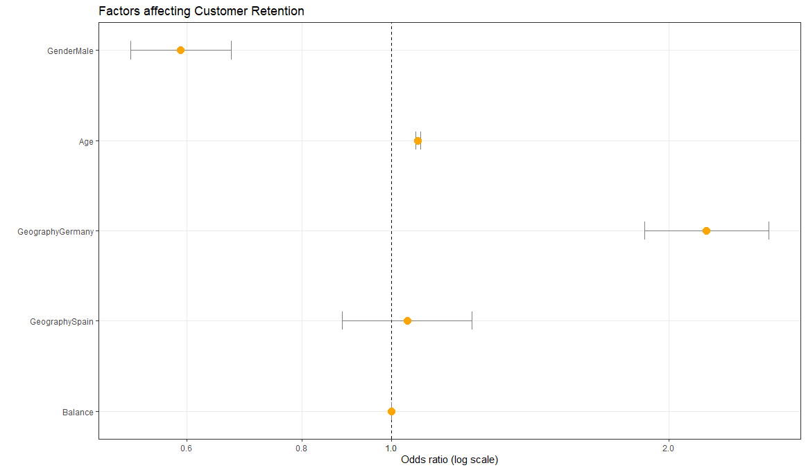
Identify favourable customers
Younger Males
Sahitya

Slide 45
Identify favourable customers
Younger Males
Address concerns of less favourable groups
59% of females
“Being able to provide for their family/children and about security and comfort”
Sahitya

Slide 46

Impact of Internal vs External factors
79.3% vs 95%
Sahitya

Slide 47
EXTENDING OUR SOLUTION

Slide 48
Creating a Personalised Solution
Understand how the significant internal retention predictors vary with each of the external variables
vs
“NumberOfComplaints” is a statistically significant predictor
Odds Ratio of “IsActiveMember” more significant
Sahitya

Slide 49
THE LIMITATIONS

Slide 50
Limitations
Inaccurate and non-representative data
Cannot rely purely on statistical model
Future Research Directions
Explore more predictors
Include a wider spectrum of categories
Collate other types of data
Utilisation of more advanced artificial intelligence models
Sahitya

Slide 51
Q & A

